Slide 1
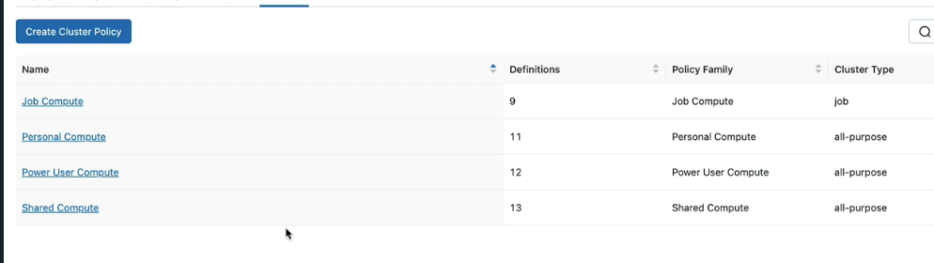
Cluster Policy [V-9]
Creating Cluster Policy
Databricks > Compute (sidebar) > Policy
Also, we have the option to create another Policy, based on one of these policies available and override
certain attributes.
So that makes it easier to create a Policy.
There are four Cluster policies available.
They are default policies created by Databricks for us.
If one of them suits our needs, we can simply use that.

Slide 2
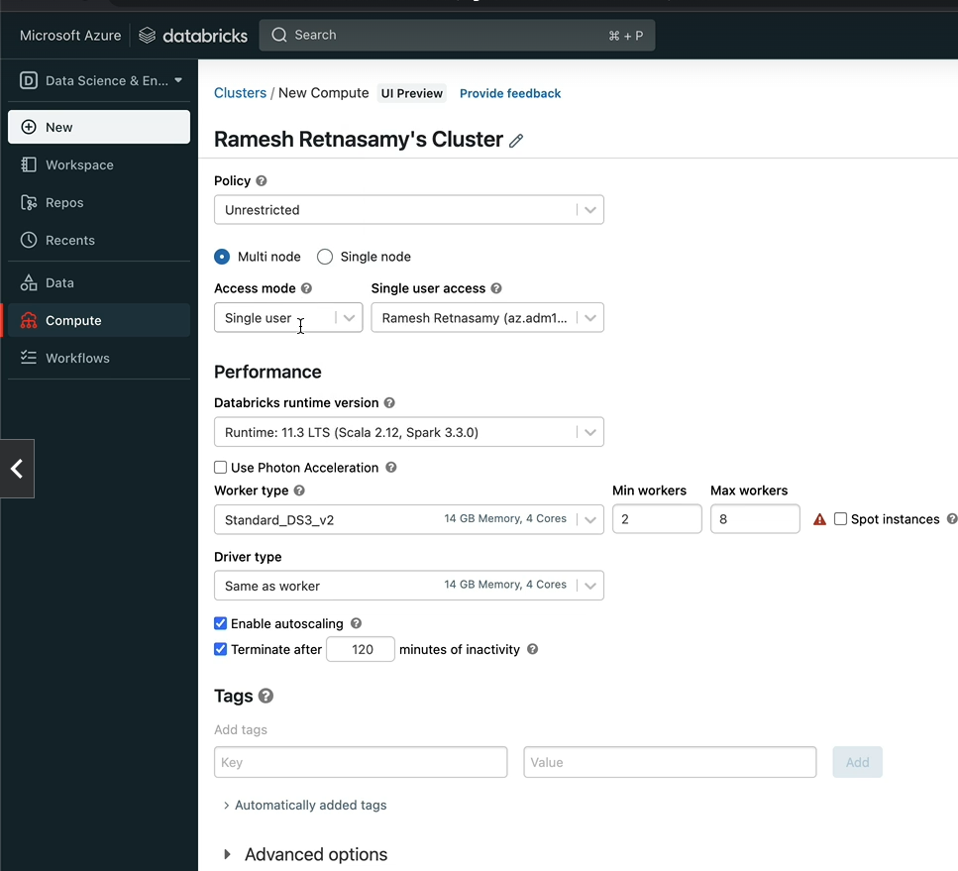
Creating Cluster Policy from scratch.
Let's define our requirement first.
Databricks > compute > All perpous Compute > Create Compute
When we select the Policy as Unrestricted, we are presented with the user interface with all the options
available to create a Cluster.
Let's say, I'm an administrator and I have a number of students taking the course that you are taking,
and I want to restrict them to create Clusters, limiting to only the needs of this project.
That means we only allow for a Single node cluster to be created.
That means, we'll pre-select Single node and we don't let them choose Multi node at all.

Slide 3
Section 9: Formula1 Project
FAE -→ Federation Internationale de l’Automobile
Association Stablished in 1947
Formula1 → Inetiay rule was that the capacity of engine is only 2.5 feet capacity and naturally asparit.

